Slide 1
Plants Reproduction and Agriculture
Chapter 6

Slide 2
In a hot summer Vimal’s father bought some fruits like watermelon, oranges,mangoes,etc to eat. Vimal love to eat watermelons. Vimals mother collected all the seeds of watermelon after eating the fruit and placed inside the small pot. Vimal asked his mother, why she is placing the seeds inside the soil. His mother replied that with in few days we can see the watermelon seeds germinating and we can get new fruits within few months. Vimal after hearing it, he watered the seeds daily to see the seeds germinating. And asked his mother whether all the plants have seeds?

Slide 3
Introduction
Plants are classified into two, they are flowering and non flowering plants.
The flowering plants bear colourful flowers and bear fruits
Some non flowering plants mosses and ferns bear tiny spores which grow into new plants.
Some cases new plants can grow even from roots, stems and leaves, etc

Slide 4
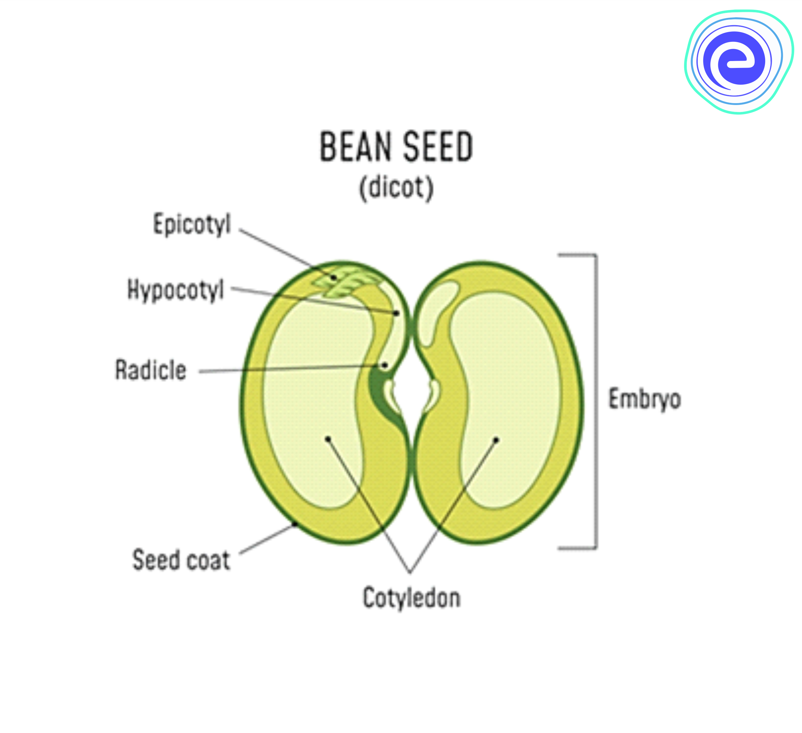
The seed
Baby plant inside the seed so the seed need a right condition for its growth
The seed is converted by the outer covering called the seed coat
Inside the seed coat there are two seed leaves called the cotyledon.
In the middle of the cotyledons contains the baby plant called the embryo
The embryo has a tiny root that grows down wards
The tiny shoot that grows upwards
The embryo for its growth receives the food from the cotyledon
Seeds with single cotyledon - rice ,wheat, etc
Seed double cotyledon % ground nut, beans ,etc

Slide 5
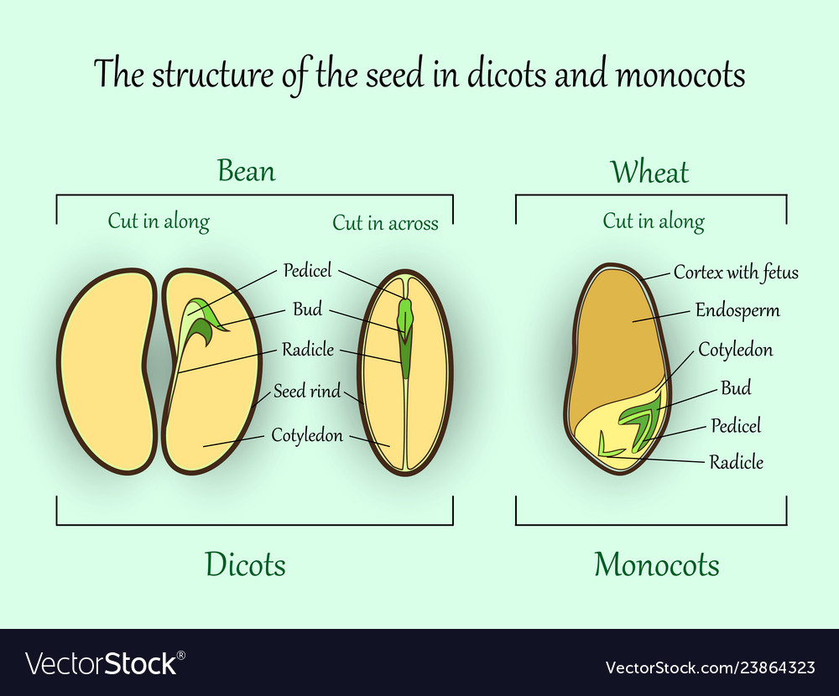
Monocot and dicot seed
https://youtu.be/WbG5zu2Vw0I

Slide 6
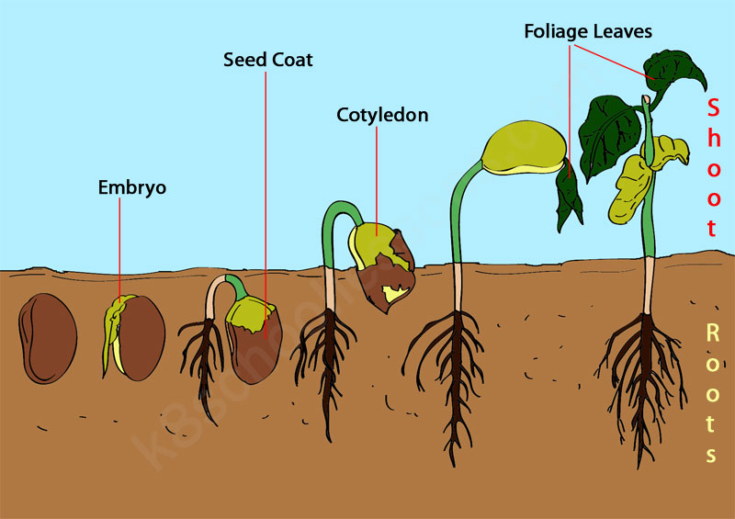
Germination
Growth of a baby plant from a seed is called Germination
Seed when gets right amount of water, sunlight and air they start germinating
When all the conditions are favourable the seed absorbed water and sweeps up and the seed coat burst open
The young root grow downwards and the young shoot grow upwards
The baby plant uses the food that is stored in the cotyledons for its growth
After the development of root the plant start to absorb the water and minerals from the soil for its growth
The shoot develops the leaves and prepare its food by photosynthesis with the help of sunlight and air

Slide 7
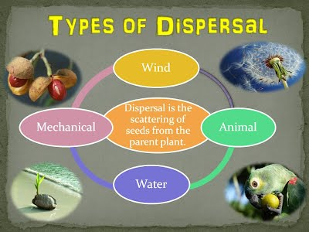
Dispersal
The action or process of distributing or spreading things over a wide area.
Plants cannot move from place to place, so the seeds fall near the mother plant.
They may not germinate as they do not get enough sunlight, air, water and minerals
Seeds disperse by different means like ….

Slide 8
Agents of Dispersion
The seeds are carried away from the parent plant to far off places by wind, water, animals or explosion of seeds
Wind , water and animals are called the agents of dispersal
https://youtu.be/3CCOWHa-qfc

Slide 9
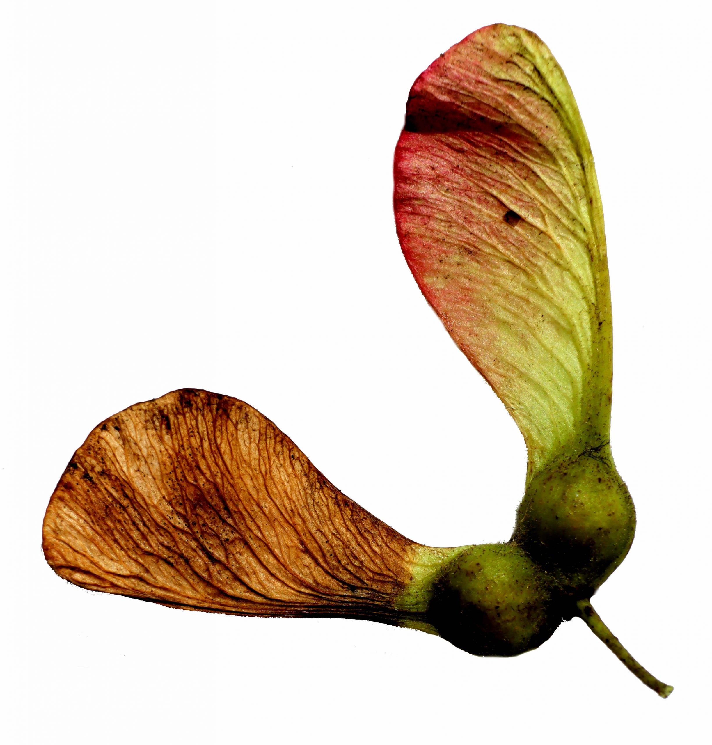
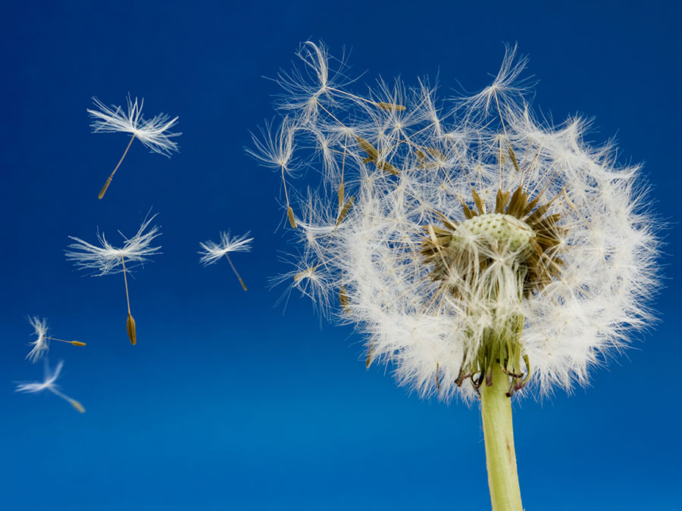
Dispersal by wind
Some seeds are very light in weight and have wings or fine hair on them
Such seeds are carried away easily by wind
Dandelion have fine hair
Sycamore have wings to float in air

Slide 10
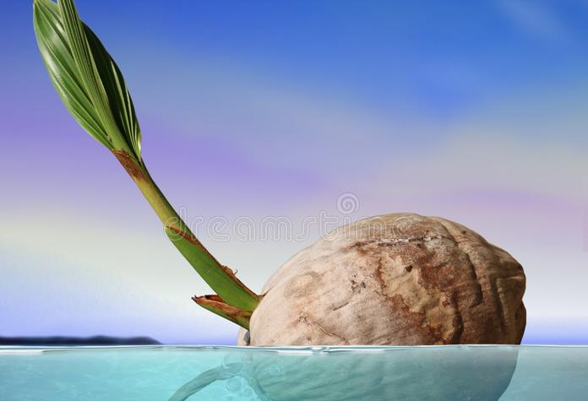
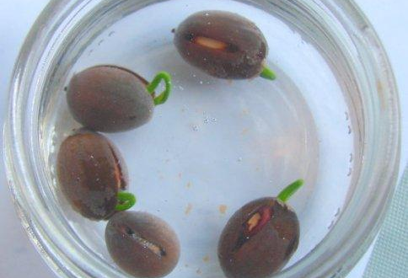
Dispersal by water
Many plants grow near water bodies
Seeds or fruit of coconut and lotus are usually carried away by the water to far off places.
Coconut are hollow covered with rough hair this makes them light to float in water
Lotus fruits has a spongy part which them to float

Slide 11
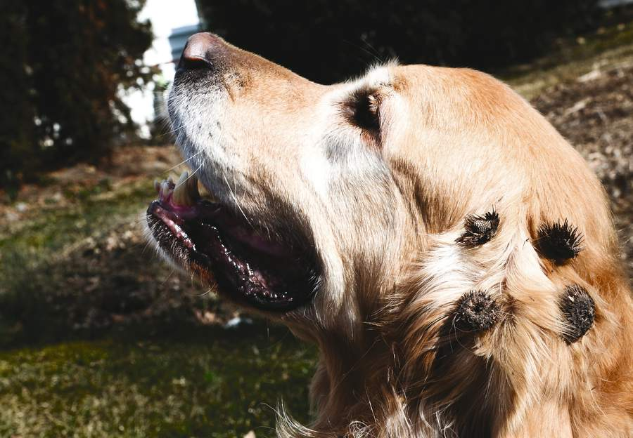
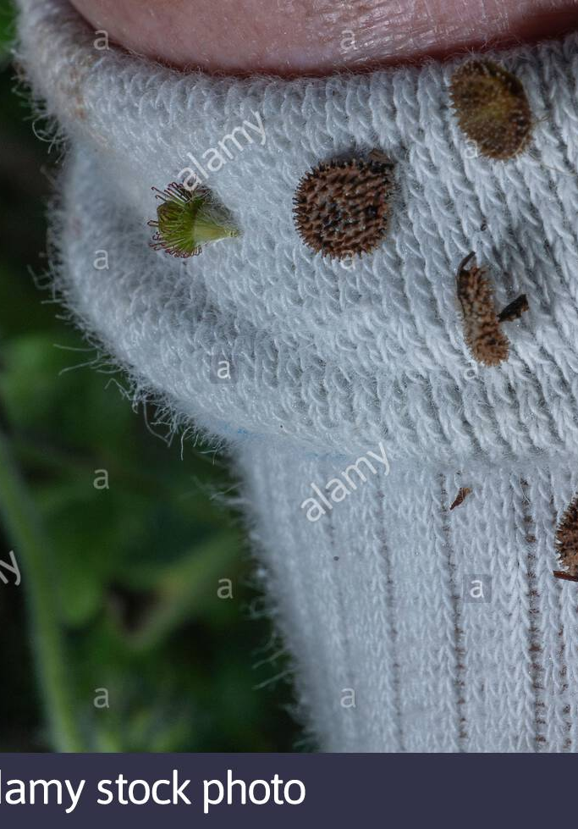
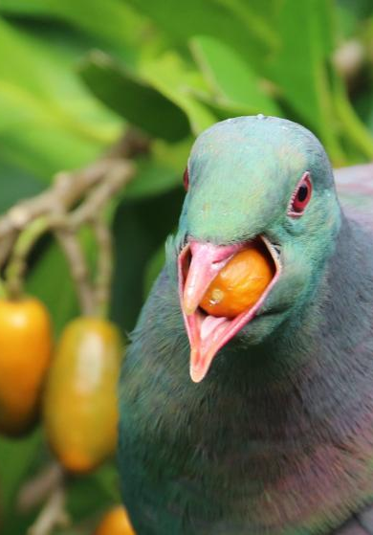
Dispersal by animals
Some seeds have hooks, spines or stiff hairs.
The seeds will stick to the body of other animals, feathers of birds or our clothes
Birds eat the fruit and the swollen seeds come out through the waste
Even we disperse the seeds as we eat the fruits like the melons, oranges, papaya,etc

Slide 12
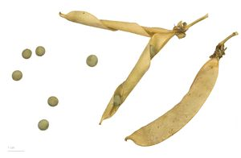
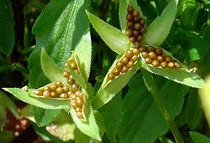
Dispersal by explosion
Fruits of some plants like the pea and balsam expose their seeds by explosion
Thus their seeds are scattered far away from the mother plant

Slide 13
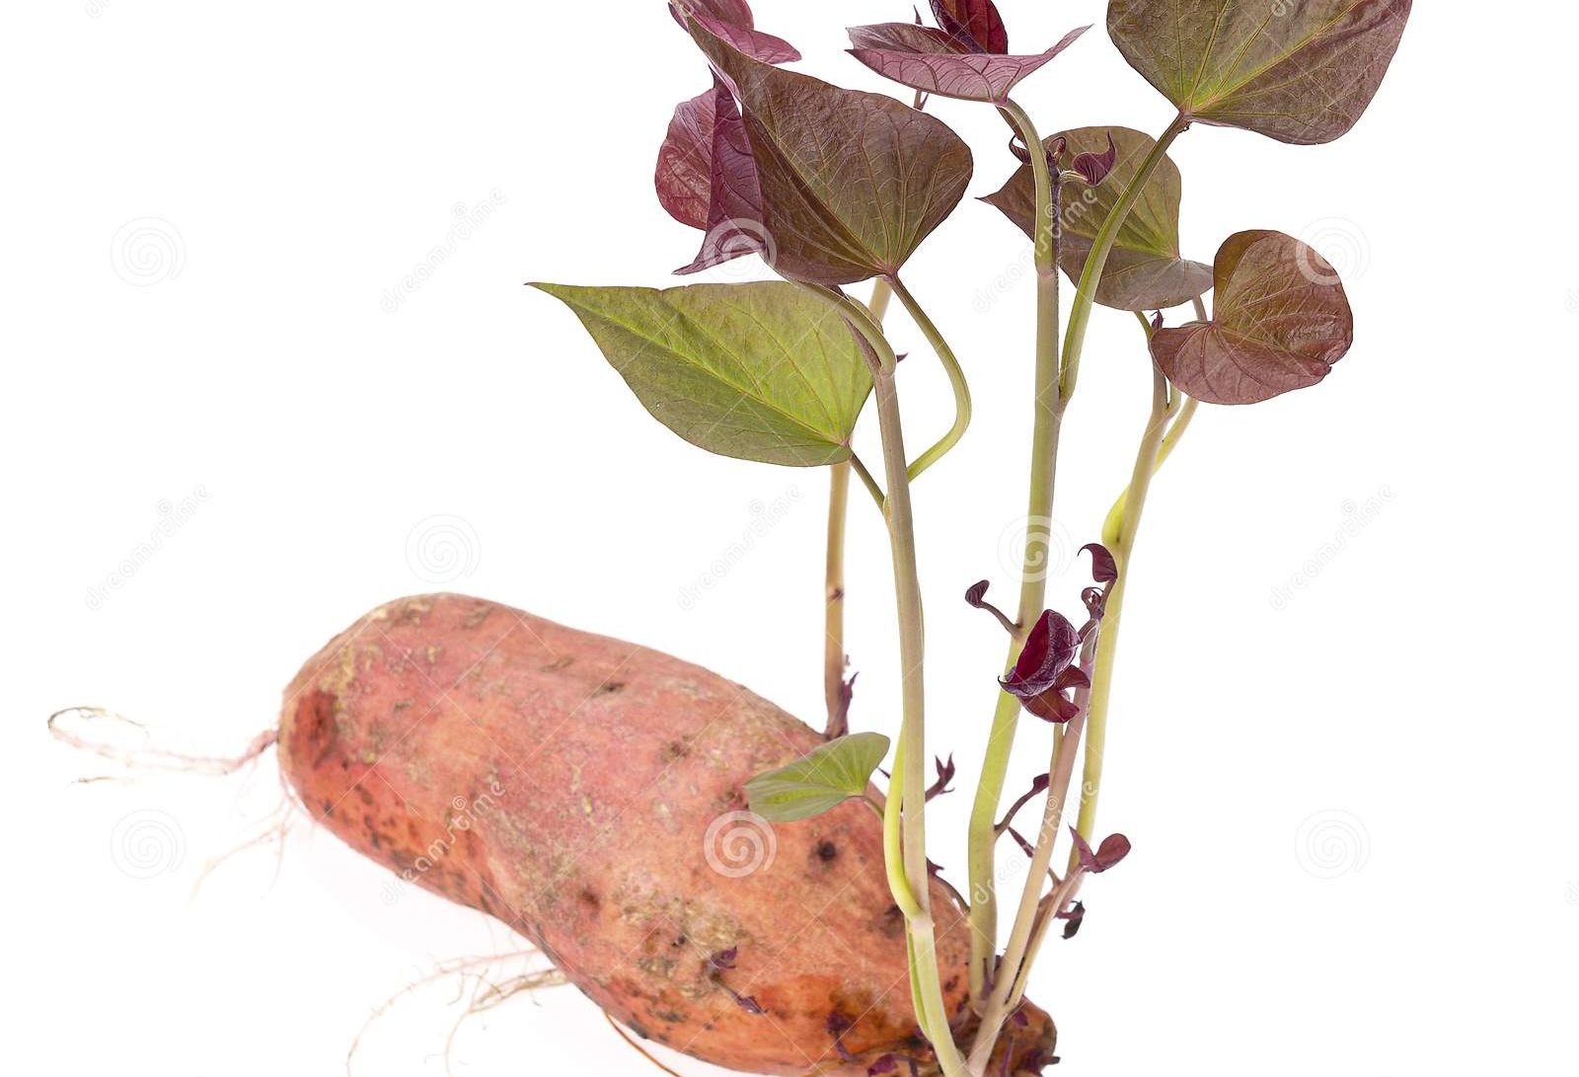
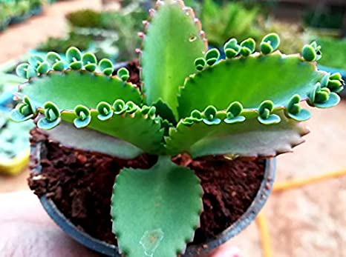
Reproduction from different parts of the plant
Most of the plants reproduce by seeds but some plants reproduce by stem, leaves, roots, etc
Root: Sweet potato
Leaves: Bryophyllum. The leaves contain the buds when they fall to the ground they grow into new plant.

Slide 14
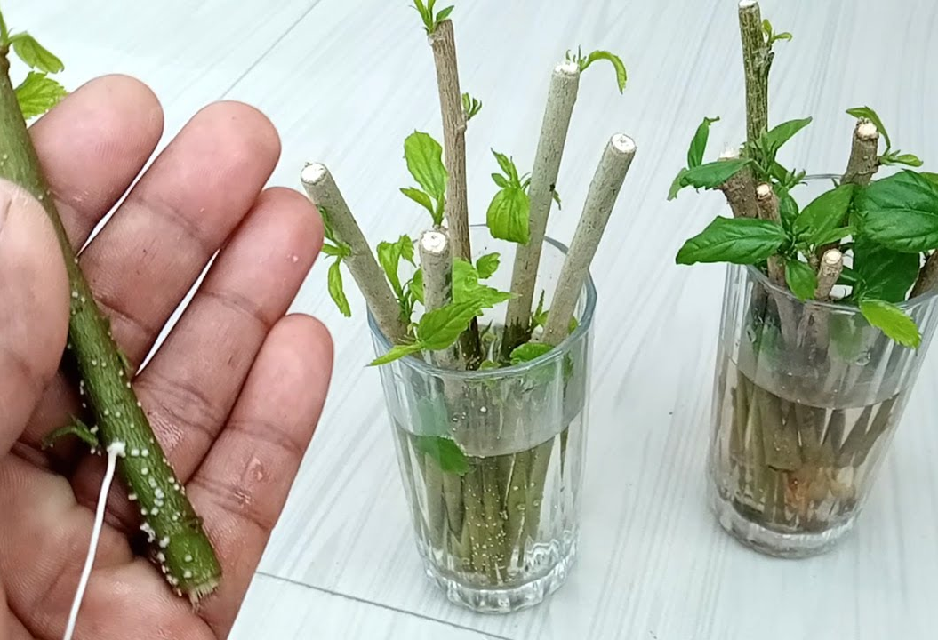
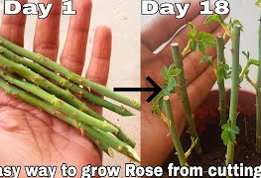
Rose and hibiscus
Stem: Rose and Hibiscus. When the stem of these plants are placed in the soil they grow into new plant.
Money plants and strawberries grow from stem cutting

Slide 15
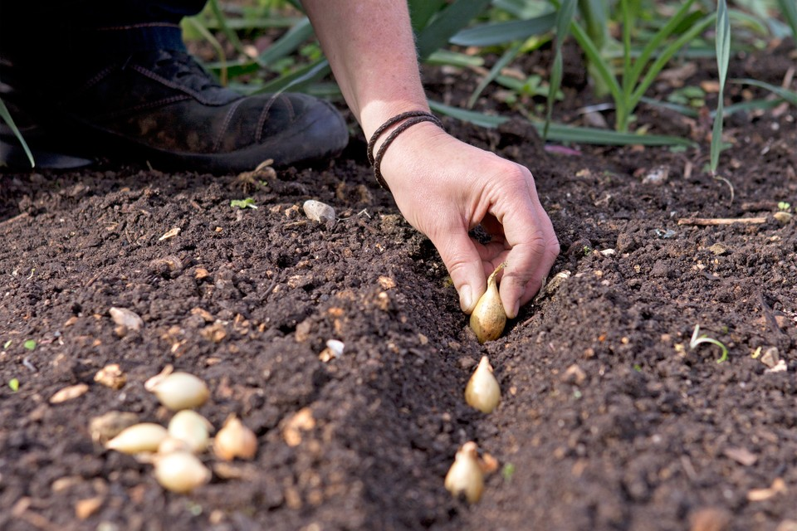
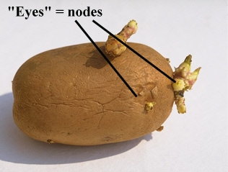
Potato and onions
Potatoes and gingers have underground stem
They have small buds on them which further develop into new plant
Onion and garlic have underground stem called as bulbs, new plants grow from the bulbs

Slide 16
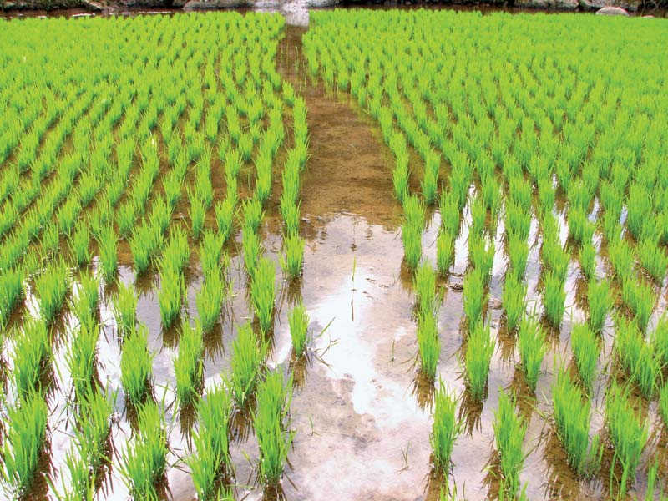
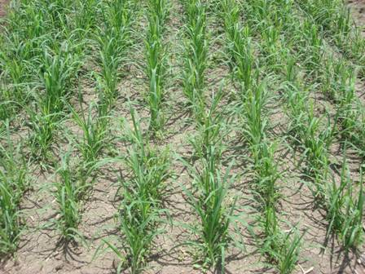
Crop and agriculture
When a crop is grown in large quantity for food, fibre, etc for our need
The practice of growing crops is called Agriculture
Different crops grow in different soil, climate and season
Rice require more water, clay soil
Bajra requires less water, sandy soil

Slide 17
Crops grown in india

Slide 19
Growing healthy crops
https://youtu.be/zAFnTF8FwF8
Good seed, water, fertiliser, pest and disease control, correct time harvest, storing in good place, etc

